Slide 1
Concept Map
Concepts to Include
Decision Between Lactate and TCA Cycle
Regulation of Pyruvate Dehydrogenase
PDK and PDH Phosphatase
Anaplerosis and Cataplerosis
Fatty Acid Synthesis
Amino Acid Oxidation
Ketogenesis
ETC Control by ADP
TCA Control of Glycolysis
Cori Cycle
Regulation of TCA Cycle
Mitochondrial Numbers
Electron Carrier Molecules
Antioxidants
Oxidative Stress

Slide 2
Announcements
First midterm is two weeks from today, review session on that Monday
Many practice questions on Problem Roulette
Rina is hosting a Study Group at Taubman Health Sciences Library at 5pm today
UDP-Galactose Epimerase swaps hydroxyl groups not UDP groups (see image to right)

Slide 3
The TCA Cycle and the ETC

Slide 4
Quiz Question #1
The final electron acceptor in the electron transport chain is
NAD (becoming NADH)
FAD (becoming FADH₂)
Pyruvate (becoming Acetyl-CoA)
O₂ (becoming H₂0)

Slide 5
Quiz Question #2
The most important metabolite for regulating activity of the electron transport chain is:
ATP
ADP
NADH
FADH₂

Slide 6
Quiz Question #3
What drives the ATP generating pump in the mitochondria?
Calcium gradient
Potassium gradient
Proton gradient
Substrate level phosphorylation

Slide 7
Learning Objectives
Describe the key regulatory nodes of the TCA cycle.
Understand the concept of anaplerosis and cataplerosis and how this can effect TCA cycle efficiency.
Explain the differences in efficiency between anaerobic glycolysis and the TCA cycle linked to the electron transport chain.
Understand how mitochondria balance nutrient flux with ATP requirements.

Slide 8
Concept Map
Concepts to Include
Decision Between Lactate and TCA Cycle
Regulation of Pyruvate Dehydrogenase
PDK and PDH Phosphatase
Anaplerosis and Cataplerosis
Fatty Acid Synthesis
Amino Acid Oxidation
Ketogenesis
ETC Control by ADP
TCA Control of Glycolysis
Cori Cycle
Regulation of TCA Cycle
Mitochondrial Numbers
Electron Carrier Molecules
Antioxidants
Oxidative Stress
Notes:
Finish this by ~ 1:50

Slide 9
Anaerobic Glycolysis
What happens to pyruvate in the absence of oxygen

Slide 10
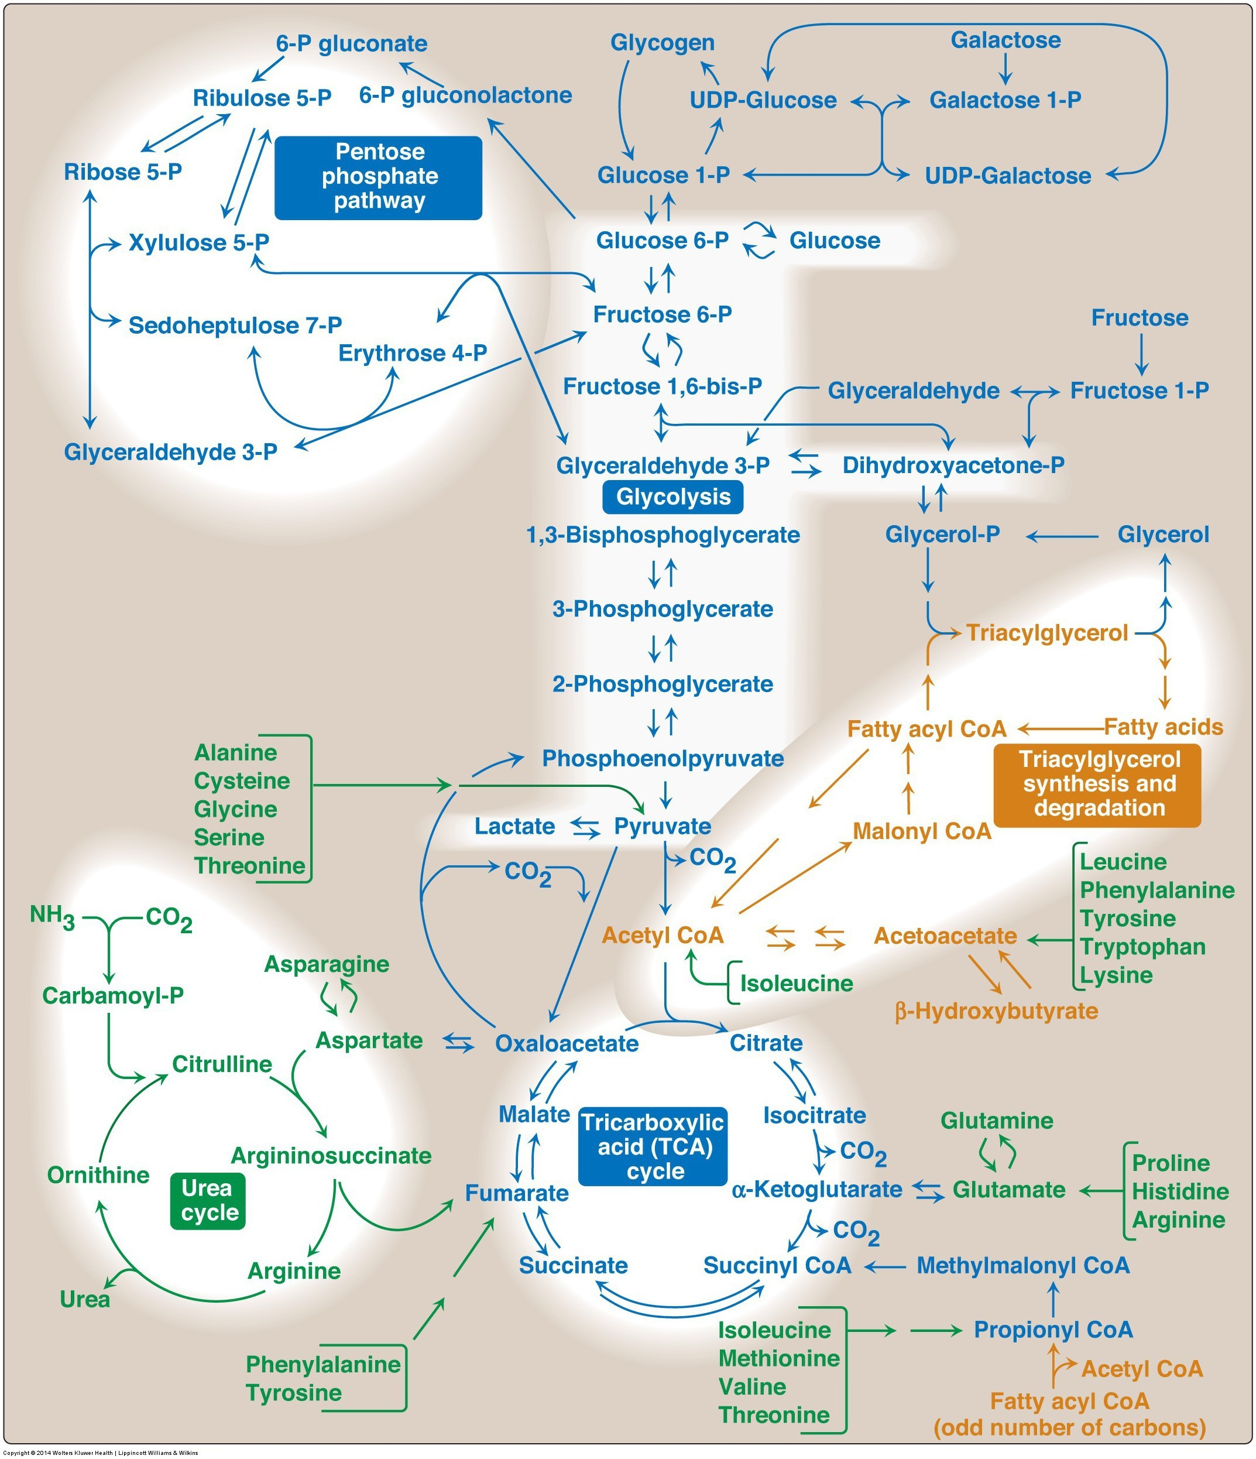
Fates of the Pyruvate from Glycolysis
Aerobic Conditions
Becomes Acetyl-CoA via PDH
In presence of CHO but need energy -> TCA Cycle
In presence of CHO but don’t need energy -> Lipids
In absence of CHO
Ketone Bodies (if OAA absent)
Anaerobic conditions
Becomes lactate
Lactate goes to liver for reconversion back to glucose
Notes:
Absent of CHO is mo

Slide 11
Lactate Dehydrogenase and the Cori Cycle
This is an example of an inefficient cycle, since you are using 4 ATP (6 used, 2 generated) each time you go around the loop
Notes:
Mention what NADH is

Slide 12
Over-arching concept: EFFICIENCY
The Cori cycle is an example of a futile cycle
You use 4 ATP molecules to basically get back to where you start
What is the relationship of this kind of cycle to
Exercise and Performance
Weight Loss

Slide 13
Pyruvate Transport and Oxidation
Notes:
Be here at ~1:55

Slide 14
TCA Cycle Net ATP
Glycolysis
Uses 2 ATP (GK/HK and PFK1) -2ATP
Generates 2 DHAP/Ga3P Each of which:
Generates 2 ATP -> +4 ATP total
Generates 1 NADH -> +5 ATP (2.5 ATP/NADH)
Net to Pyruvate-> 5 + 4 – 2 = 7ATP
Net to Lactate
Uses 1 more NADH for each pyruvate -> +2 ATP
Through TCA/ETC ~ 32 ATP
Each pyruvate generates 4 NADH, 1 FADH2 and 1 ATP
Glycolysis (Glucose to Pyruvate) = 7ATP
4 NADH x 2.5 = 10 ATP x 2 Pyruvates = 20 ATP
1 FADH x 1.5 = 1.5 ATP x 2 Pyruvates = 3 ATP
1 GTP = 1 ATP x 2 Pyruvates = 2 ATP

Slide 15
Pyruvate Oxidation Occurs in Mitochondria
All three of the next steps are mitochondrial
Pyruvate Oxidation
TCA Cycle
Electron Transport Chain
Pyruvate needs to be transported into mitochondria
Not thought to be regulated, but mitochondrial import is rate limiting for fatty acid oxidation

Slide 16
The mitochondria is the powerhouse of the cell
Notes:
Mention the radiolab podcast

Slide 17
The number of mitochondria per cell can be modified

Slide 18
Pyruvate Dehydrogenase
Making acetyl-CoA, this enzyme controls flow through TCA or Cori cycle

Slide 19
Beriberi and Wernicke-Korsakoff Syndrome
Thiamine (Vitamin B1) is a cofactor for PDH as well as some other enzymes (aKGDH, BCKDH)
Ethanol inhibits thiamine uptake in GI system
Questions to discuss
What would happen to glucose metabolism?
What would happen to lactate levels?
How would this affect exercise tolerance
How could you treat
Symptoms include
Lactic acid and pyruvate buildup
High output cardiac failure
Exercise intolerance
Neurodegeneration, numbness, poor reflexes -> WKS
Rare now that grains are now fortified with Thiamine

Slide 20
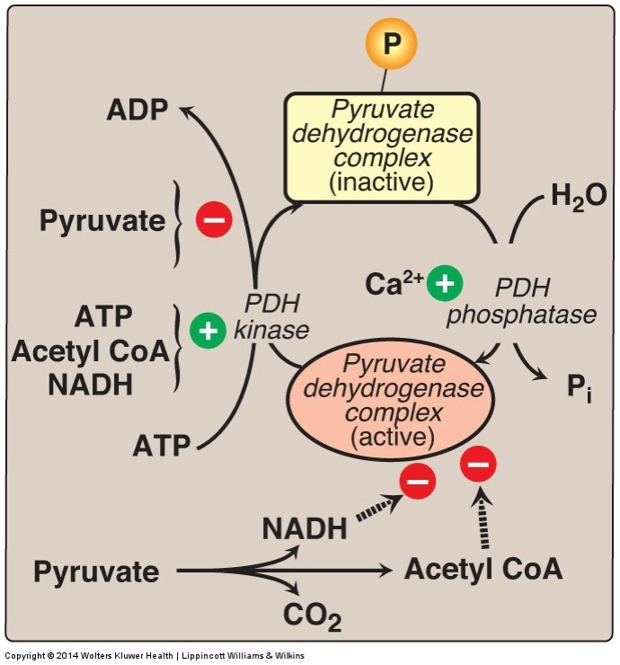
How is the decision made whether pyruvate should become Lactate or Acetyl-CoA
Allosteric regulators
NADH
Acetyl-CoA
Through Phosphorylation and inactivation by PDH Kinase
ATP
NADH
Acetyl-CoA
Pyruvate
Ca

Slide 21
Glucocorticoids increase PDK expression, what would this do?
Increase alanine/pyruvate flow towards gluconeogenesis or lactate
Increase alanine/pyruvate flow towards oxidation
Increase Acetyl-CoA flow towards gluconeogenesis or lactate
Increase Acetyl-CoA flow towards oxidation
Notes:
Answer is B

Slide 22
The Role of Pyruvate Dehydrogenase Kinases
Inactivates PDH
Forces pyruvate towards lactate or gluconeogenesis
Depends on activity of pyruvate carboxylase
PDK4 transcription is stimulated by glucocorticoids and HIF1
Reversed by PDH phosphatases
Same as BCKDH phosphatase

Slide 23
Think/Pair/Share
PDK Inhibitor
PDK (Pyruvate Dehydrogenase Kinase) inhibition has been suggested to be a be useful target in Type 2 Diabetes
How would an inhibitor affect PDK activity
How would that affect PDH activity
How would that affect glucose/lactate utilization?
How would that affect type 2 diabetes
PDK
PDK
PDH (off)
PDH (on)
Less Glucose Oxidation
More Glucose Oxidation
Less Glucose in the Blood

Slide 24
What happens to the Acetyl-CoA?

Slide 25
Acetyl-CoA can now go in several directions

Slide 26
The Fates of Acetyl-CoA
In presence of CHO but need energy -> TCA Cycle
Key enzymes are Citrate Synthase, aKGDH and IDH (TCA Cycle)
In presence of CHO but don’t need energy -> Lipids
Key enzymes are ATP-Citrate Lyase and Acetyl-CoA Carboxylase (Lipids Unit)
In absence of CHO
Ketone Bodies (if OAA absent), only in liver
No OAA to react with in Citrate Synthase step

Slide 27
ETC/TCA Regulation
Three layers of regulation
TCA Enzyme Activity
Anaplerosis/Cataplerosis
ETC Flux
Regulation of TCA enzyme activity

Slide 28
Simple View of the TCA Cycle
The outcomes of this reactions are
NADH and FADH₂ will be used in the electron transport chain
GTP can be interconverted to ATP
Both carbons that were part of Acetyl-CoA are now released as CO₂
Acetyl-CoA + 3 NAD⁺ + FAD + GDP + P_{i} + 2 H₂O | → CoA-SH + 3 NADH + FADH₂ + GTP + 2 CO₂
Notes:
Mention CO2 is totally irreversible

Slide 29
The Regulated Steps of the TCA Cycle
Citrate Synthase
NADH, FADH₂, ATP
OAA, AMP
Isocitrate Dehydrogenase
NADH, ATP
ADP, Ca²
α-Ketoglutarate Dehydrogenase
NADH
Ca²⁺
Notes:
Steps 1, 3 and 4 are the regulated steps.

Slide 30
ETC/TCA Regulation
Three layers of regulation
TCA Enzyme Activity
Anaplerosis/Cataplerosis
ETC Flux
Anaplerosis and Cataplerosis

Slide 31
Other metabolites feed into, or take from the TCA cycle
Fatty Acid biosynthesis draws from citrate
Amino Acids feed into and draw from several steps in the TCA cycle
Notes:
All but one amino acid group feeds into the cycle AFTER the regulated steps

Slide 32
Anaplerosis and Cataplerosis

Slide 33
Which of the following is a cataplerotic pathway
Gluconeogenesis
Lysine catabolism
Fatty acid oxidation
Glycolysis
Notes:
Answer is A

Slide 34
How does anaplerosis regulate glycolysis?
Oxaloacetate inhibits pyruvate kinase
Oxaloacetate inhibits phosphofructokinase 2
Citrate inhibits pyruvate kinase
Citrate inhibits phosphofructokinase 2
Notes:
Answer is D

Slide 35
What if you you are too cataplerotic?
X
Ketone Bodies

Slide 36
Molecular Basis for Ketosis
Aerobic Conditions
Becomes Acetyl-CoA
In presence of CHO but need energy -> TCA Cycle
In presence of CHO but don’t need energy -> Lipids
In absence of CHO
Ketone Bodies (if OAA absent)

Slide 37
Summary of Regulation of the TCA Cycle/ETC
Key points of regulation include:
Mitochondrial levels
Pyruvate/Acetyl-CoA production (Glycolysis/Fatty Acid Oxidation)
Energy levels (AMP/ADP/ATP and NADH, FADH₂)
Levels of TCA cycle intermediates
Intramitochondrial calcium levels

Slide 38
ETC/TCA Regulation
Three layers of regulation
TCA Enzyme Activity
Anaplerosis/Cataplerosis
ETC Flux
Regulation of ETC Flux

Slide 39
What is a NADH (or a FADH₂ or a NADPH)

Slide 40
What enzymes are regulated by Energy Status?
AMP/ADP/ATP
NADH/FADH₂
Glycolysis
PFK1
Pyruvate Kinase
Pyruvate Dehydrogenase
TCA Cycle
Citrate Synthase
Isocitrate Dehydrogenase
Pyruvate Dehydrogenase
Pyruvate Dehydrogenase Kinase (inhibitory to PDH)
α-Ketoglutarate Dehydrogenase
Hormonal regulation of the TCA cycle?
Notes:
Hormones

Slide 41
The ETC uses the electron carriers to generate a proton gradient

Slide 42
Respiratory Control by Energy Needs
All substrates
are present

Slide 43
Respiratory Control Thought Experiment
How does a lack of oxygen eventually reduce the flow of pyruvate through the TCA cycle?
Remember there is no direct O₂ sensing at any of these steps

Slide 44
Over-arching concept: EFFICIENCY (again)
Are there any reasons why you may want to have inefficient coupling of the electron transport chain?
What happens to the energy from metabolic reactions if it isn’t converted to another chemical

Slide 45
Inefficient Coupling of the ETC
Are there any reasons why you may want to have inefficient coupling of the electron transport chain?

Slide 46
Brown Adipose Tissue and Thermogenesis

Slide 47
Learning Objectives
Describe the key regulatory nodes of the TCA cycle.
Understand the concept of anaplerosis and cataplerosis and how this can effect TCA cycle efficiency.
Explain the differences in efficiency between anaerobic glycolysis and the TCA cycle linked to the electron transport chain.
Understand how mitochondria balance nutrient flux with ATP requirements.

